Slide 1
ONLINE SPORTS ATTENDANCE MANAGEMENT SYSYTEM

Slide 2

INTRODUCTION
TITLE:ONLINE SPORTS ATTENDANCE MANAGEMENT SYSTEM
NAME:P.SAHAYOGESHWARANROLLNO:21CSC132
GUIDE NAME:MS. RANI V
MCA.,M.Phil.,MEd.,PGDSA.,SET.
DEPARTNMENT OF COMPUTER SCIENCE & APPLICATION

Slide 3


PROJECT SPECIFICATION TITLE:ONLINE SPORTS ATTENDANCE MANAGEMENT SYSTEM PLATFORM:WINDOWS FRONTEND:PHP BACKEND:MYSQL IDE:VISUAL STUDIO

Slide 4

SOLUTION:
. The system is developed to provide automation for the daily attendance
of the students and teachers. The purpose of this system is to help.
improve the attendance monitoring system for students and teachers. With the system created
with a user-friendly.
PROBLEM:This system developed will reduce the manual work and avoid redundant data. By maintaining the attendance manually, then efficient reports cannot be generated. The system can generate efficient weekly, consolidate report based on the attendance. As the attendances are maintained in registers it has been a tough task for admin and staff to maintain for long time. Instead the software can keep long and retrieve the information when needed.
SCOPE AND OBJECTIVES
Scope (Lifetime of Usability)
The project has a very vast scope in future. The project can be implemented on intranet in future. Project can be updated in near future as and when requirement for the same arises, as it is very flexible in terms of expansion. With the proposed software of database Space Manager ready and fully functional the client is now able to manage and hence run the entire work in a much better, accurate and error free manner.
Applications and Merits
Highlight the applications and advantages of the proposed system.
The system benefits various stakeholders, including organizers, participants, and spectators.

Slide 5



USE CASE ANALYSIS
1. Participant:
The participant is an individual attending a sports event.
Key Operations:
Register for an account.
View upcoming sports events.
View attendance history.
2. Spectator:
Spectators are individuals attending sports events but without a direct participation role.
Key Operations:
Register for an account.
Access event information and updates.
3. Organizer:
Organizers are responsible for planning, creating, and managing sports events.
Key Operations:
Create and publish sports events.
Manage event details, including name, date, time, and location.
View and analyze attendance reports.
Send event notifications to participants and spectators.

Slide 6


Administrator (Admin):
Administrators are responsible for system management, user support, and data security.
Key Operations:
Manage user accounts, including registration and access control.
Ensure system security and compliance with data protection regulations.
Provide support for users' technical issues.
Backup and data recovery procedures.
Actor: Organizer
Operations:
The organizer logs in to the system.
The organizer initiates event creation.
The system collects event details (name, date, time, location).
Use Case Administrator Manages User Accounts
Actor: Administrator
Operations:
The administrator accesses the system's user management interface.
The administrator assists users with technical issues.
The administrator conducts regular data backup procedures.

Slide 7


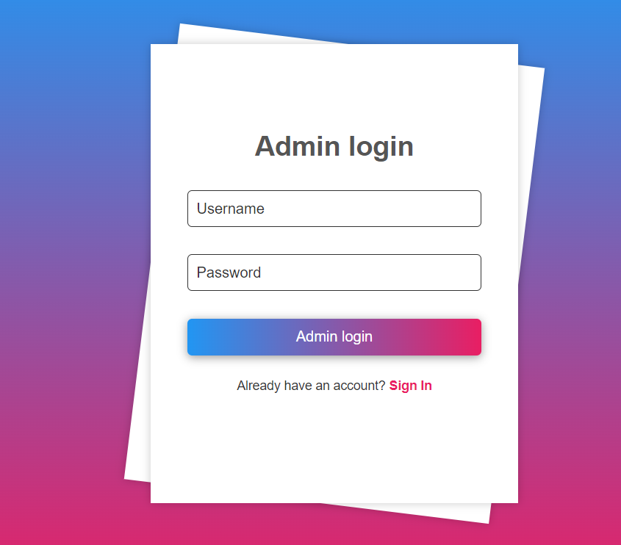
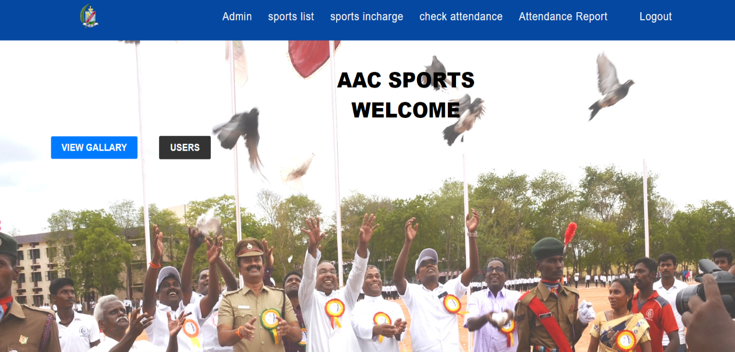
OUTPUT DESIGN

Slide 8
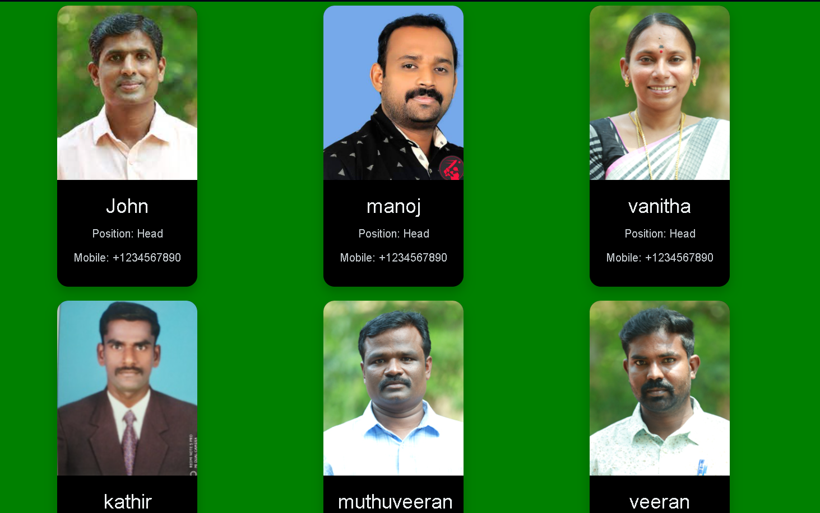
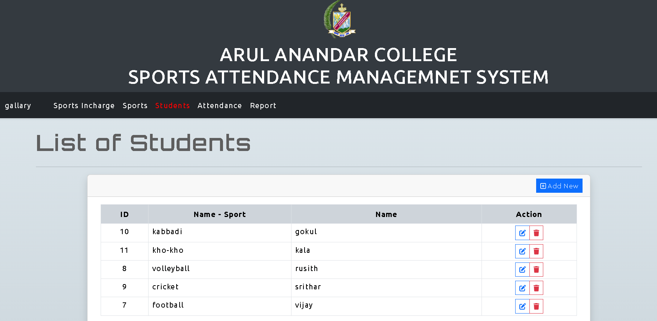
STUDENT DETAIL
UPLOAD:
FACULTY
01

Slide 9
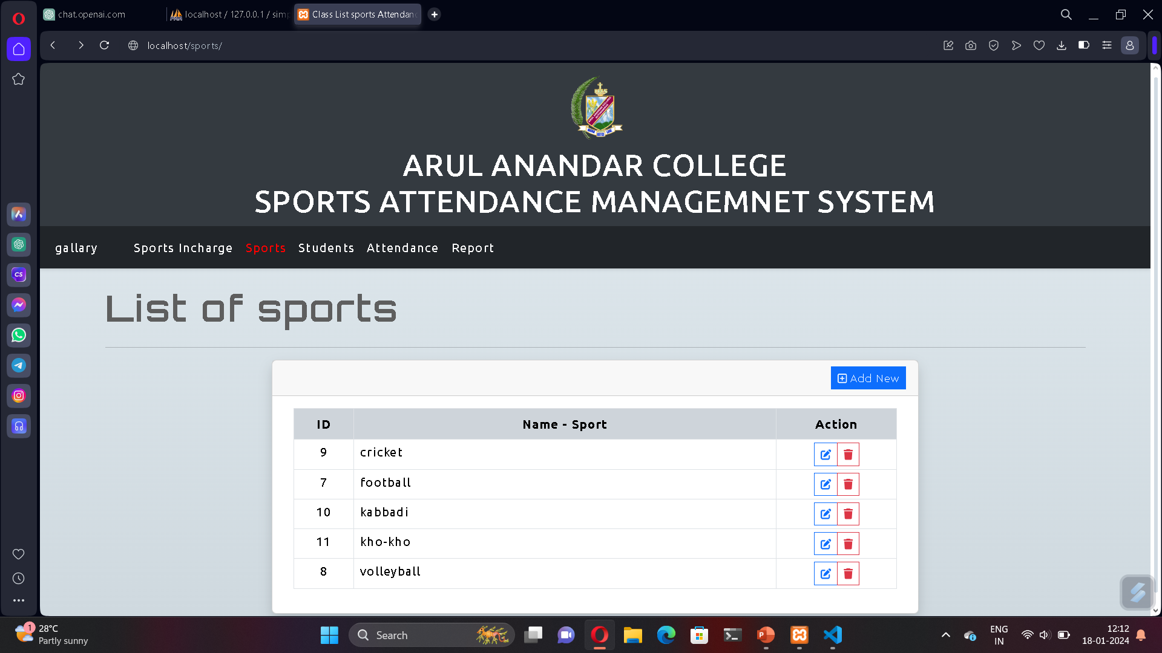
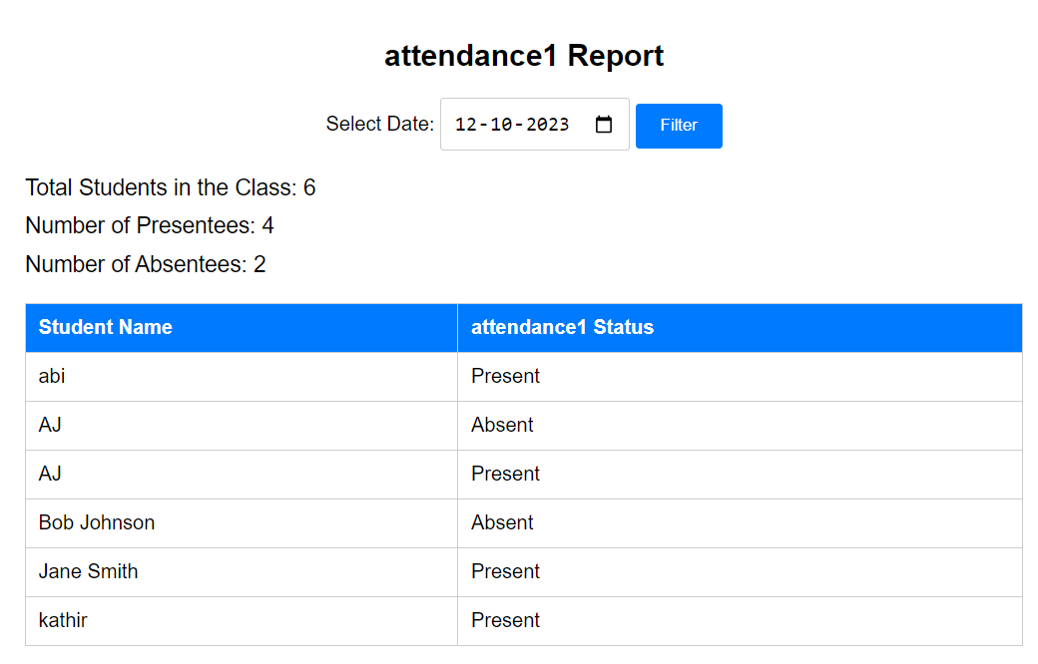
SPOTRS SELECTION
ATTENDANCE REPORT

Slide 10


1. “PHP and mysql web development”-luke welling and laur thomson-addison –wesley-5th edition-2016
2.”Modern PHP”- josh lockhart-o’Reily Media- 1st edition-2015
3.”PHP: The complete Reference”-steven holzner-McGraw-hill education-1st edition-2008.
4. “Eloquent Javascript”-Marijn haverbeke –n/a-3rd edition-2020.
5. “JavaScript:The definitive guide”-David Flanagan-o’Reily Media- 7th edition-2020
REFRENCES
https:// www.w3schools.com.
https://www.geeksforgeeks.org.
https://chat.openai.com.
https://github.com.
https:// devdocs.io.

Slide 11

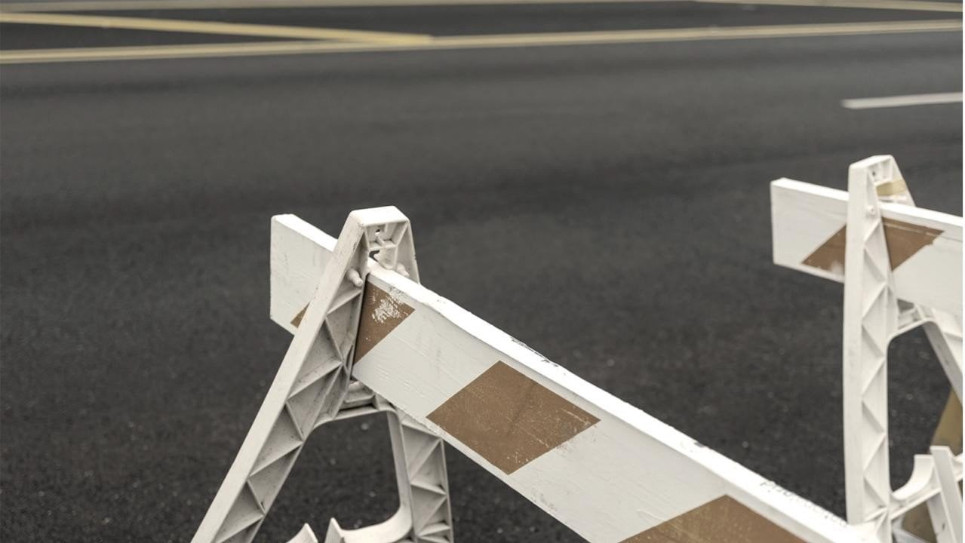
CONCLUSION
The online sports Attendance Management System is fully meets the objectives of the system which it has been developed. The system has reached a steady state where all bugs have been eliminated. The system is operated at a high level of efficiency and all the teachers and user associated with the system understands its advantage. The system solves the problem. It was intended to solve as requirement specification.

Slide 12






Event Management:
The portal enables the SPORTS ATTENDDANCE management and events, from event creation and registration to participant tracking and reporting.
Document Submission:
Cadets can typically use the portal to submit necessary documents, reports, and streamlining administrative processes.
User and Admin Control:
The portal typically includes user and admin control features, ensuring that access is restricted to authorized individuals and that administrators can manage user accounts and permissions.
Updates and Announcements: Regular updates and announcements are made available to keep cadets and administrators informed about the latest developments and events.

Slide 13

Efficient Attendance Tracking: The system offers efficient and accurate attendance tracking for both participants and spectators, and a check-ins.
Real-time Updates: The system ensures that attendance data is updated in real-time, empowering organizers with the ability to make informed decisions and plan events effectively.
User-Friendly Interface: The web application and mobile app offer a user-friendly interface, simplifying registration, event creation, and attendance monitoring.

Slide 14

THANK YOU

